Slide 1

G2M INSIGHT FOR CAB INVESTMENT FIRM
LISUM 14
21/10/2022

Slide 2
BACKGROUND WORK
Problem Statement: XYZ is a private firm company in US. And they are planning to invest in cab industry due to the more growth in cab industry.
Object: Providing the analysis to help the xyz company to identify the right company to invest.
For Analysis we have four data sets. They are
Cab_Data.csv – this file includes details of transaction for 2 cab companies
Customer_ID.csv – this is a mapping table that contains a unique identifier which links the customer’s demographic details
Transaction_ID.csv – this is a mapping table that contains transaction to customer mapping and payment mode
City.csv – this file contains list of US cities, their population and number of cab users

Slide 3
DATA ANALYSIS STEPS
I did the following steps to analyse the given data
Data sets Merging
Understanding the data
Data Wrangling
Data Visualization

Slide 4
EXPLORATORY DATA ANALYSIS
I have merged the given four datasets into a single dataset using pandas.
I have changed the date of travel data type to date time
I have selected the data with in the given range i.e., 2016-01-31 to 2018-12-31.
I was used describe function in pandas to get Descriptive Statistics

Slide 5
DATA PRE PROCESSING
I have checked for the null values and duplicate data, There is no null values and duplicate data in the dataset.
I have checked for the outliers in the dataset. There is no outliers in the dataset except price charged , but there is no sufficient information so I ignored these outliers.

Slide 6
DATA VISUALISATION
I used tableau to viaualise the data .
I was calculated profit by using cost of trip and price charged

Slide 7
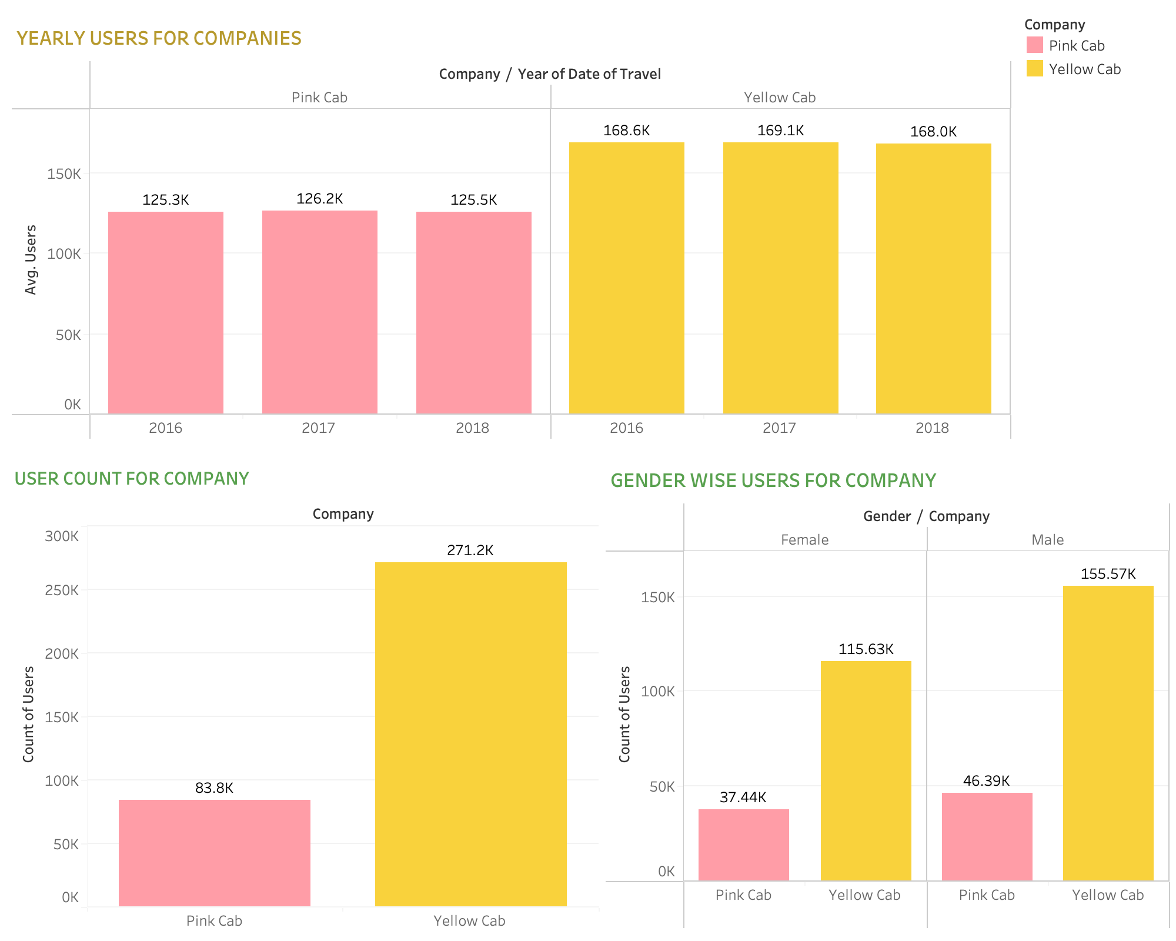
USER ANALYSIS
According to the Graphs pink cab is having less users compared to the Yellow cab

Slide 8
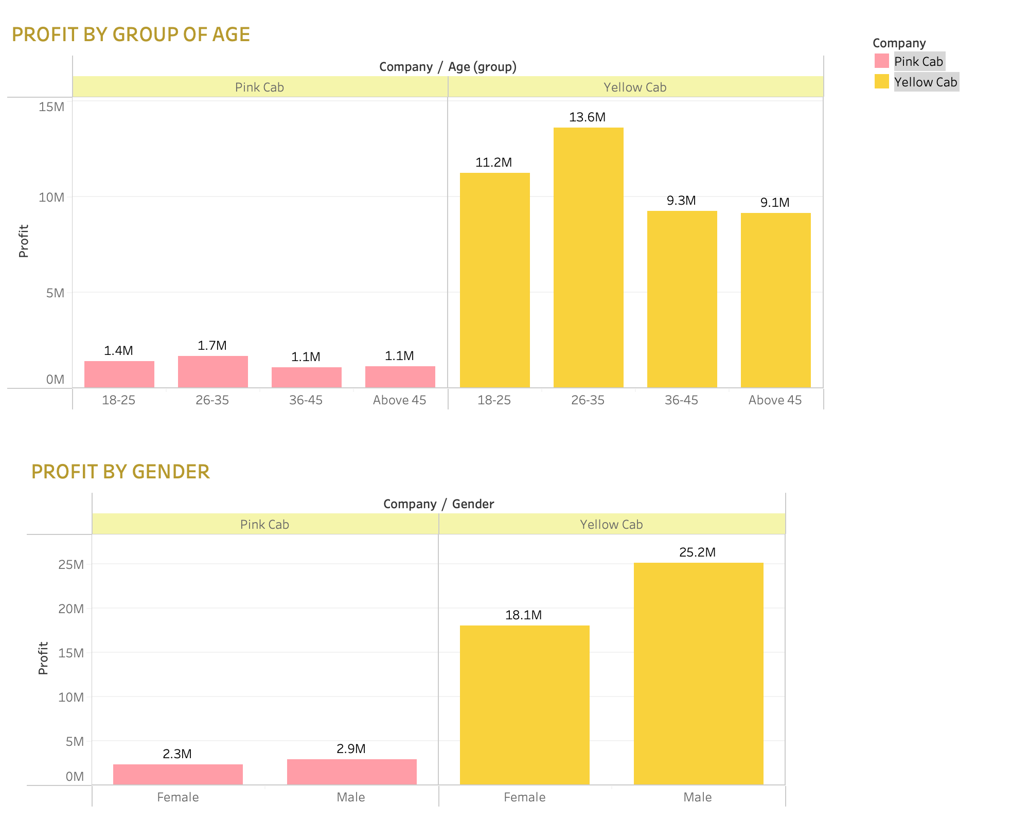
PROFIT ANALYSIS
For Yellow cabs 26-35 age group contribution is high in profits compared to other age groups.
Male and Female contribution is approximately equal in profits for pink cabs. But for yellow cabs male contribution is little bit high compared to female.

Slide 9
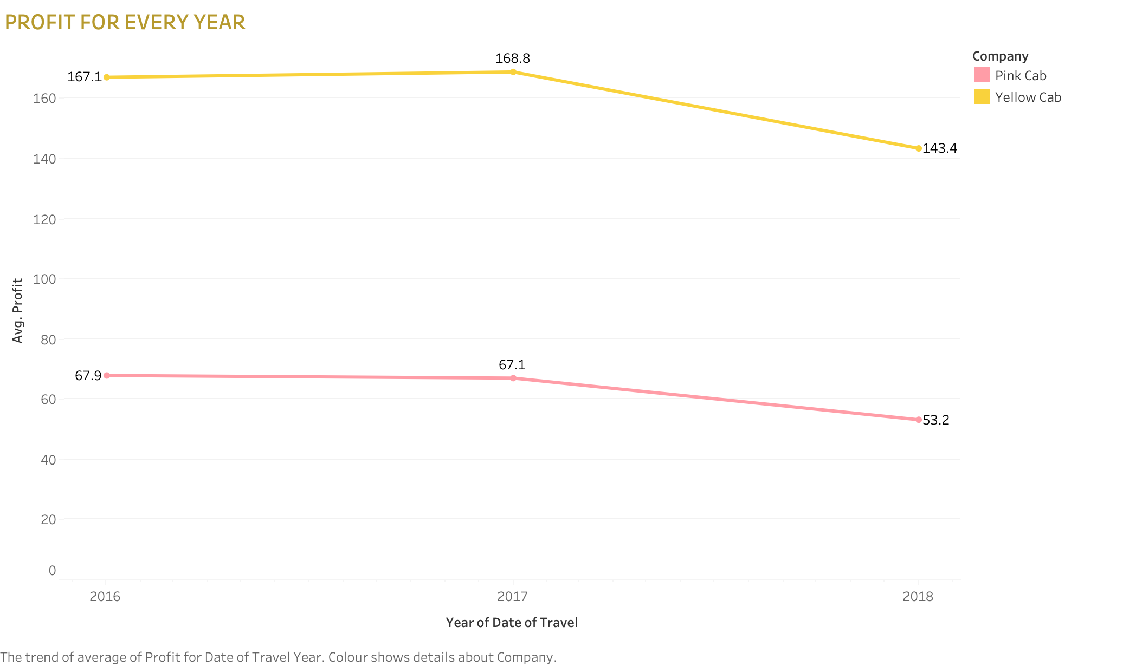
PROFIT PER YEAR FOR BOTH CABS
Compared to both cabs yellow cabs having high profits.
By individually for yellow cabs profit rate was decreased in 2018
For Pink cabs profit rate decreased from 2016 to 2017 is little bit and from 2017 to 2018 it decreased more.

Slide 10
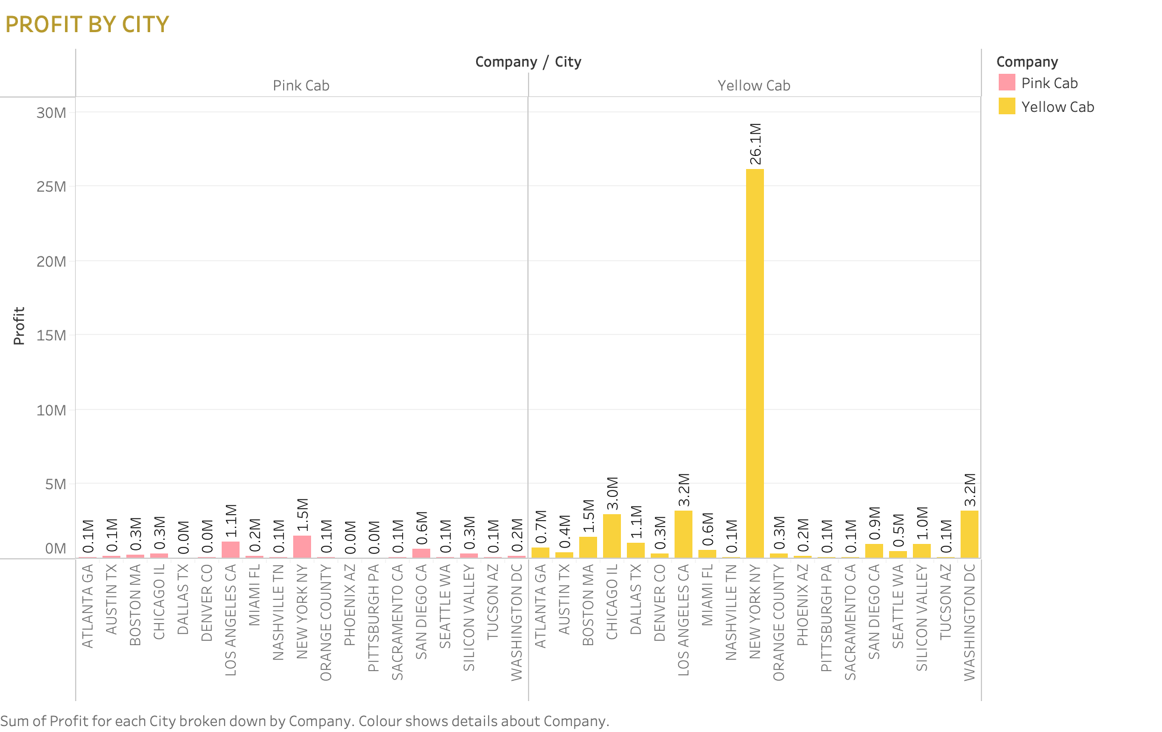
PROFIT RATE BY CITY
We know that yellow cab having high profit rate compared to pink cab
For yellow cabs we have high profit rate in New York city. That means New York people are using mostly yellow cabs.

Slide 11
RECOMMENDATIONS
By comparing with yellow cab pink cab having the less count of users.
Yellow cab is high in profit rates.
For every investment firstly we prefer for the profits. So I recommend Yellow cab for client to invest.

Slide 12
Thank You

